Slide 1
Blind estimation of acoustic transfer functions (ATFs) and dereverberation based on convolutive transfer functions (CTFs) Date：2024. 05. 22
Telecom Electroacoustics Audio(TEA) Lab
Presenter:
Anchi Yuan
Notes:
Hello everyone
I’m today’s presenter siang. I’m going to share some of my present work in source separation problem. My topic is comparative studies of source separation using semi-blind and blind source separation approaches.

Slide 2
Outline
麥克風支架
麥克風固定件

Slide 3
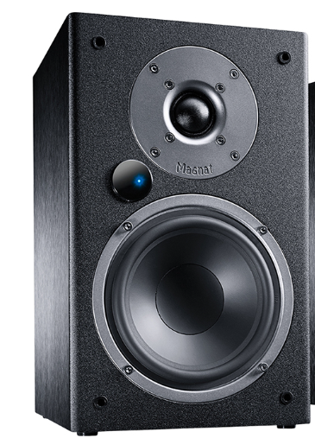
麥克風支架
角鐵
mic
1m x 1m x 1m frame

Slide 4
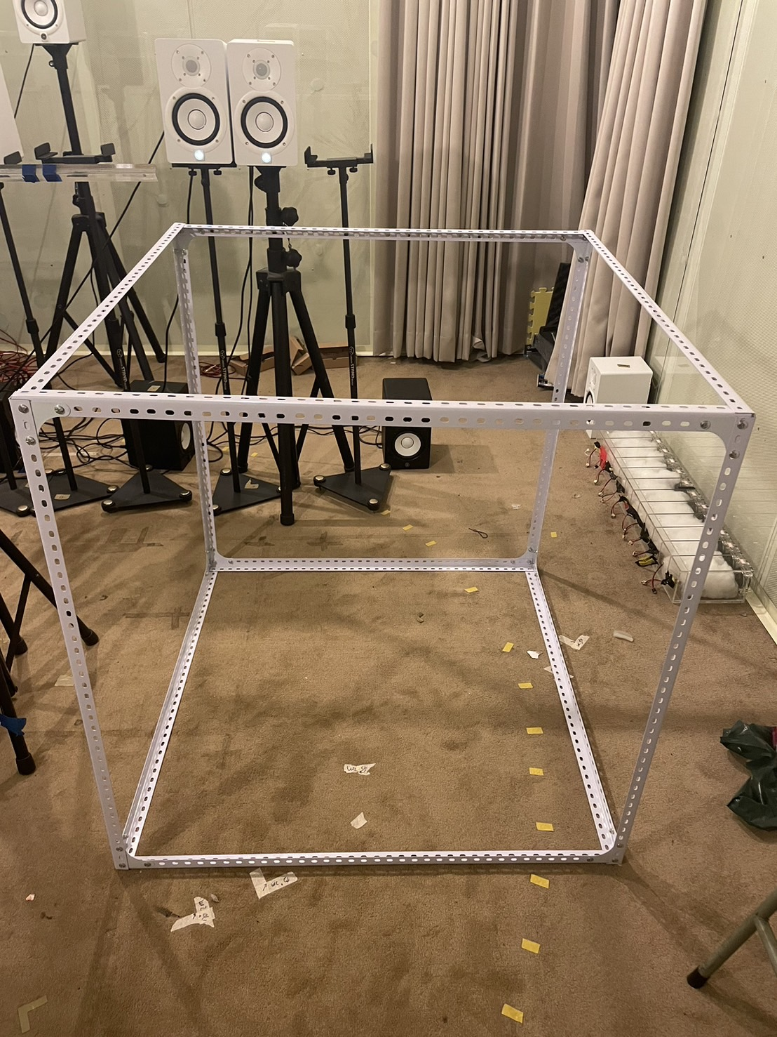
麥克風支架

Slide 5
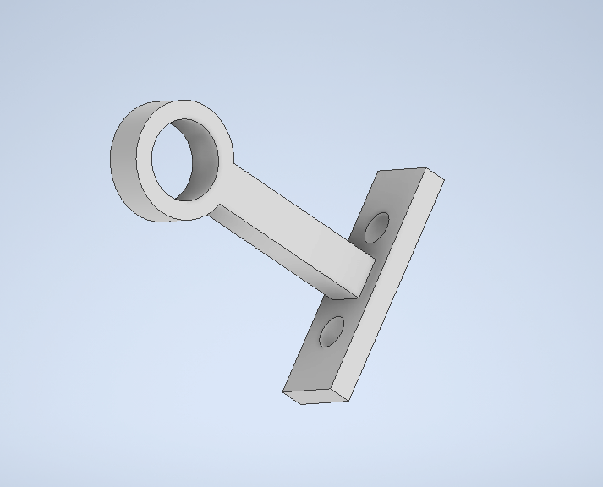
麥克風固定件

Slide 6
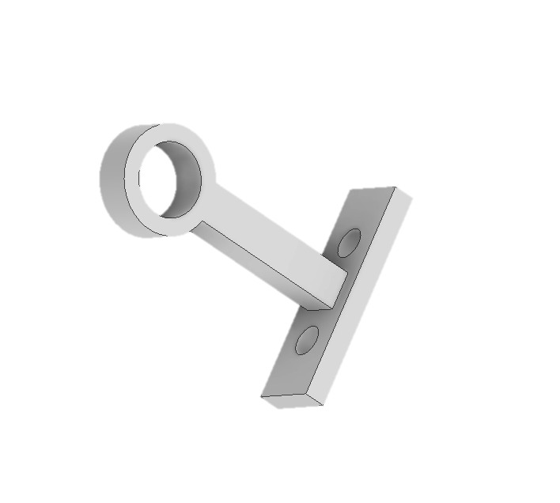
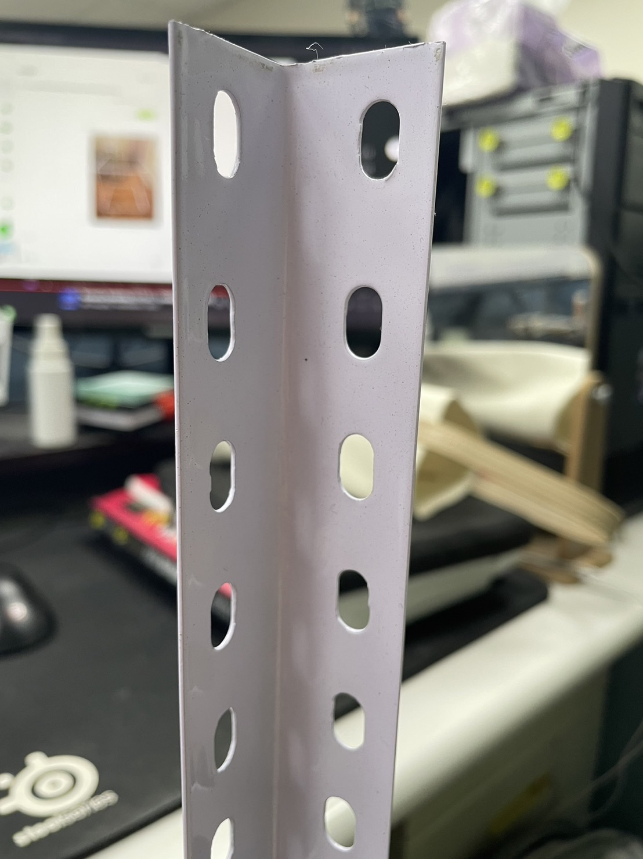
麥克風固定件

Slide 7
